Slide 1
INSTALLING & CONFIGURING SERVERS

Slide 2
Post-Installation Configuration of Windows Server 2012

Slide 3
Overview
Overview of Post-Installation Configuration Configuring Server Network Settings How to Join a Domain Activating Windows Server 2012 Configuring a Server Core Installation Demonstration: Using DISM to Add Windows Features

Slide 4
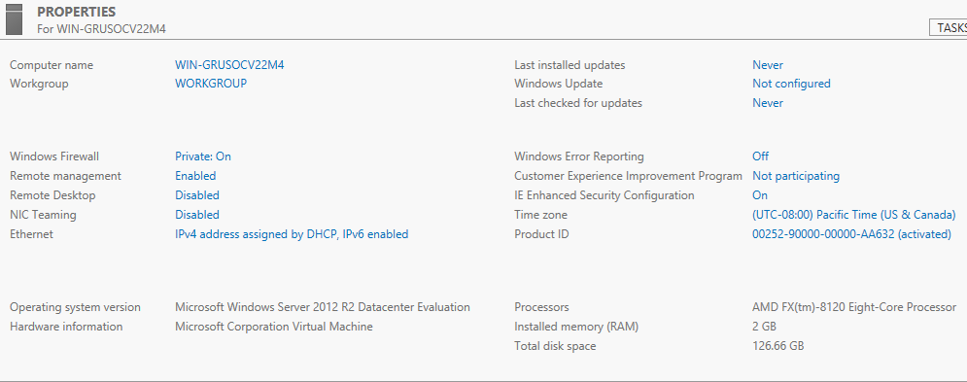
Overview of Post-Installation Configuration

Slide 5
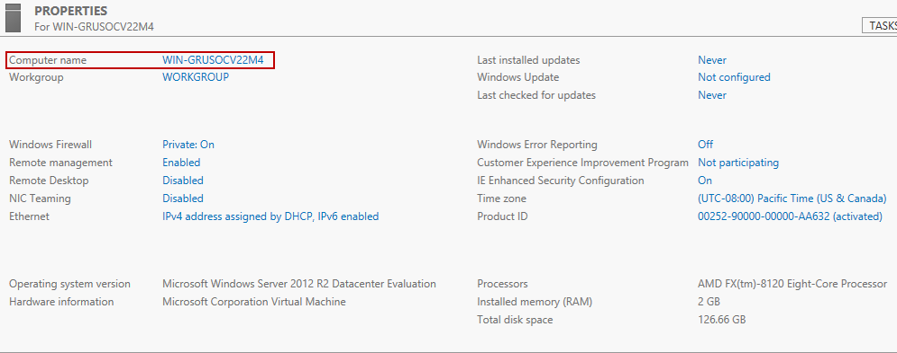
Overview of Post-Installation Configuration (Contd.)

Slide 6
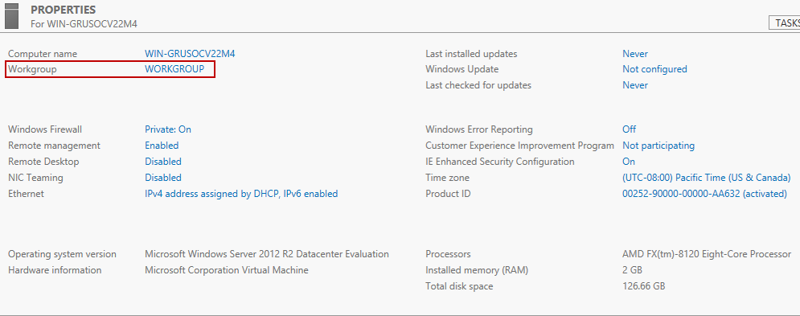
Overview of Post-Installation Configuration (Contd.)

Slide 7
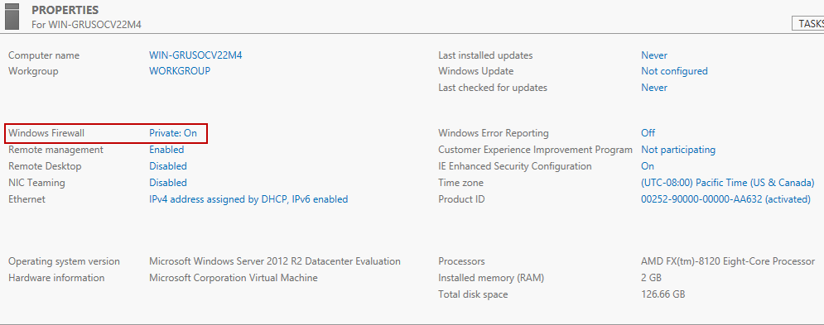
Overview of Post-Installation Configuration (Contd.)

Slide 8
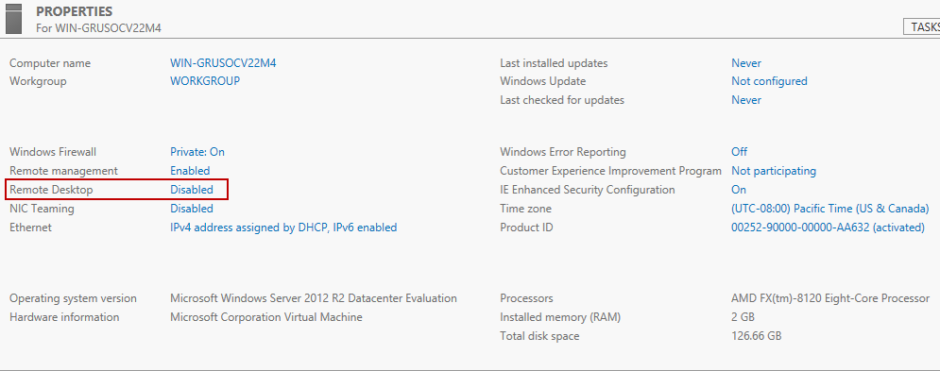
Overview of Post-Installation Configuration (Contd.)

Slide 9
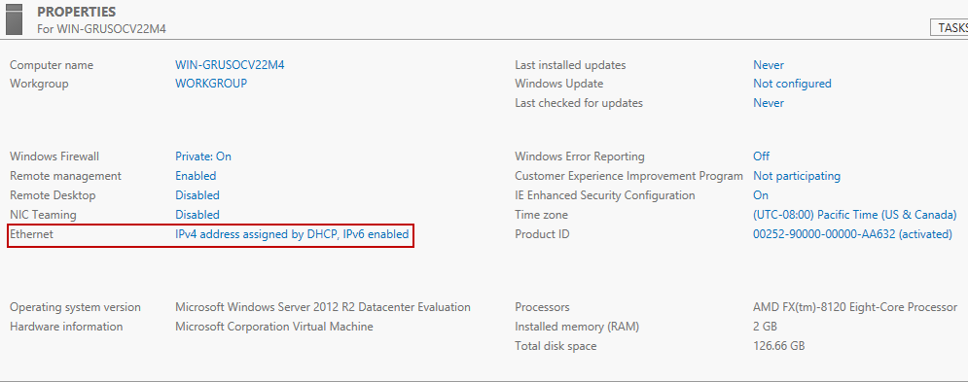
Overview of Post-Installation Configuration (Contd.)

Slide 10
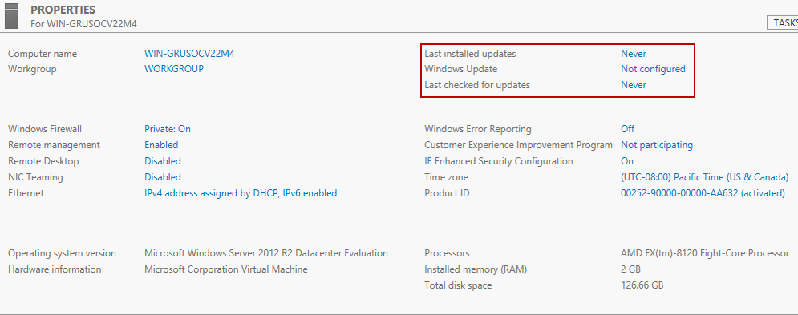
Overview of Post-Installation Configuration (Contd.)

Slide 11
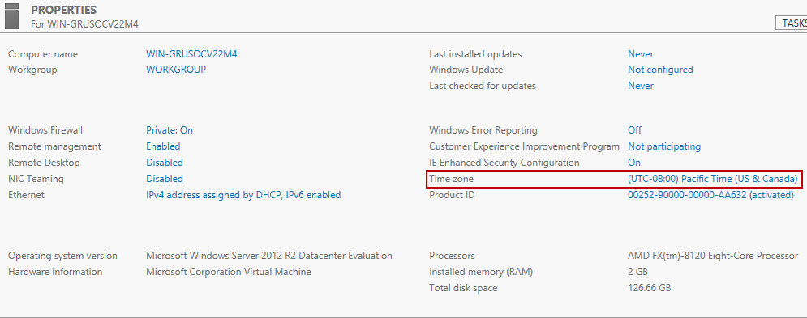
Overview of Post-Installation Configuration (Contd.)

Slide 12
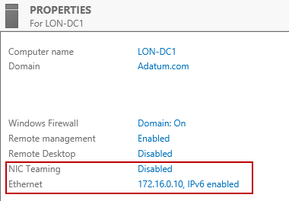
Configuring Server Network Settings

Slide 13
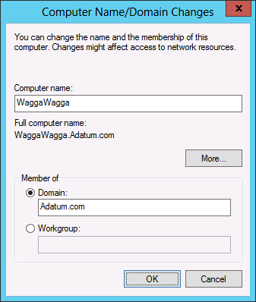
How to Join a Domain
Information necessary for a domain join:
Domain name
Account with permission to join the computer to the domain

Slide 14
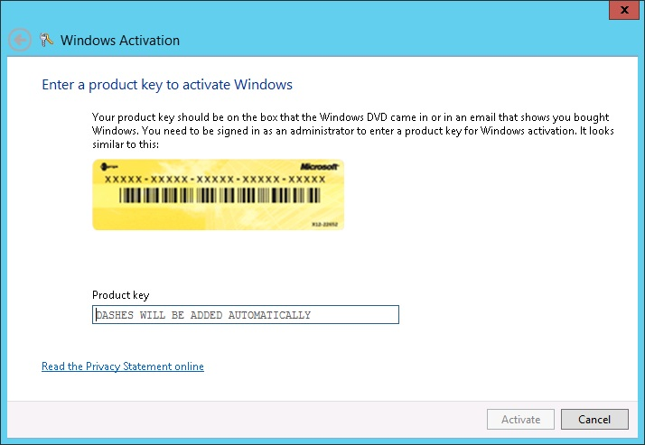
Activating Windows Server 2012

Slide 15
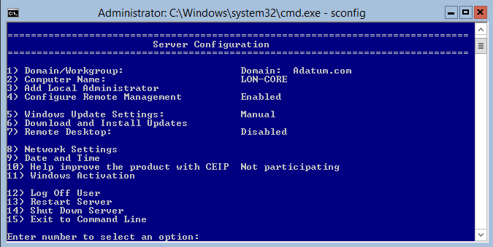
Configuring a Server Core Installation

Slide 16
Thank you

